Slide 1

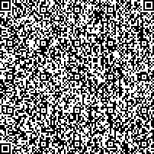
One of the Global One money management products or services
Proof of Account Details
Capitec Bank
19/09/2025
Branch: 470010
Device: 9003
To Whom it May Concern
We hereby confirm that Malibongwe Mkela has the following account(s) at Capitec Bank Limited on 19/09/2025
Client Details
Name:
ID/Passport Number: Address:
Postal Address:
Malibongwe Mkela 8202035872088
9 NEELS STREET, LAMBTON GARDENS, GERMISTON, JOHANNESBURG, 1401
9 NEELS STREET, LAMBTON GARDENS, GERMISTON, JOHANNESBURG, 1401
Account Details Account Status: Account Type: Account Number: Bank Name: Branch Code:
Date Opened:
Active Savings 1247811989
Capitec 470010
2010-12-28
The account details provided herein should not be read as extending by implication to any other matters not specifically addressed. The account details are given as at the above date and no obligation is hereby assumed to update the account details on any future date.
Capitec Bank Limited shall have no liability whether in contract, delict (including without limitation negligence) or otherwise to the above accountholder or any third party in relation to the account details contained herein.
24hr Client Care Centre 0860 10 20 43 E ClientCare@capitecbank.co.za capitecbank.co.za
Capitec Bank is an authorised financial services (FSP46669) and registered credit provider (NCRCP13). Capitec Bank Limited Reg. No.: 1980/003695/06. Page 1 of 1

